Slide 1
PHP – Database Functions

Slide 2
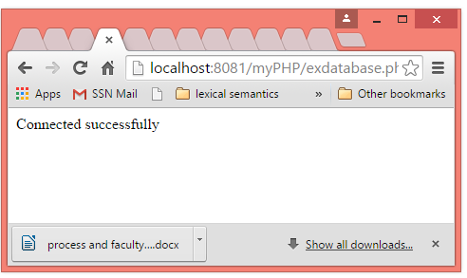
PHP – Checking the connectivity of the database
<?php $servername = "localhost"; $username = “root"; $password = “saritha"; // Create connection $conn = new mysqli($servername, $username, $password); // Check connection if ($conn->connect_error) { die("Connection failed: " . $conn->connect_error); } echo "Connected successfully"; ?>

Slide 3
Database Creation
<?php $servername = "localhost"; $username = "username"; $password = "password"; // Create connection $conn = new mysqli($servername, $username, $password); // Check connection if ($conn->connect_error) { die("Connection failed: " . $conn->connect_error); } // Create database $sql = "CREATE DATABASE myDB"; if ($conn->query($sql) === TRUE) { echo "Database created successfully"; } else { echo "Error creating database: " . $conn->error; } $conn->close(); ?>

Slide 4
Table Creation
<?php
$servername = "localhost";
$username = "root";
$password = "saritha";
$dbname = "myDB";
// Create connection
$conn = new mysqli($servername, $username, $password, $dbname);
// Check connection
if ($conn->connect_error) {
die("Connection failed: " . $conn->connect_error);
}
// sql to create table
$sql = "CREATE TABLE MyGuests (
id INT(6) UNSIGNED AUTO_INCREMENT PRIMARY KEY,
firstname VARCHAR(30) NOT NULL,
lastname VARCHAR(30) NOT NULL,
email VARCHAR(50),
reg_date TIMESTAMP
)";
if ($conn->query($sql) === TRUE) {
echo "Table MyGuests created successfully";
} else {
echo "Error creating table: " . $conn->error;
}
$conn->close();
$conn->close();
?>

Slide 5
Record Insertions
<?php
$servername = "localhost";
$username = "root";
$password = "saritha";
$dbname = "myDB“;
// Create connection
$conn = new mysqli($servername, $username, $password, $dbname);
// Check connection
if ($conn->connect_error) {
die("Connection failed: " . $conn->connect_error);
}
$sql = "INSERT INTO MyGuests (firstname, lastname, email)
VALUES ('Praba', 'Ramesh', 'praba@ssn.com')“;
if ($conn->query($sql) === TRUE) {
echo "New record created successfully";
} else {
echo "Error: " . $sql . "<br>" . $conn->error;
}
$conn->close();
?>

Slide 6
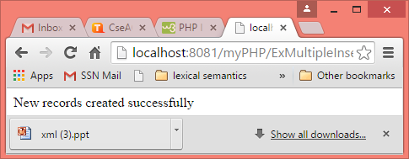
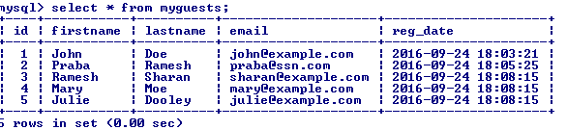
Multiple Insertion in Table
$username = "root";
$password = "saritha";
$dbname = "myDB";
// Create connection
$conn = new mysqli($servername, $username, $password, $dbname);
// Check connection
if ($conn->connect_error) {
die("Connection failed: " . $conn->connect_error);
}
$sql = "INSERT INTO MyGuests (firstname, lastname, email)
VALUES ('Ramesh', 'Sharan', 'sharan@example.com');";
$sql .= "INSERT INTO MyGuests (firstname, lastname, email)
VALUES ('Mary', 'Moe', 'mary@example.com');";
$sql .= "INSERT INTO MyGuests (firstname, lastname, email)
VALUES ('Julie', 'Dooley', 'julie@example.com')";
if ($conn->multi_query($sql) === TRUE) {
echo "New records created successfully";
} else {
echo "Error: " . $sql . "<br>" . $conn->error;
}
$conn->close();
?>

Slide 7
Selection of data
<?php
$servername = "localhost";
$username = "root"; $password = "saritha"; $dbname = "myDB“;
// Create connection
$conn = new mysqli($servername, $username, $password, $dbname);
// Check connection
if ($conn->connect_error) {
die("Connection failed: " . $conn->connect_error);
}
$sql = "SELECT id, firstname, lastname FROM MyGuests";
$result = $conn->query($sql);
if ($result->num_rows > 0) {
// output data of each row
while($row = $result->fetch_assoc()) {
echo "id: " . $row["id"]. " - Name: " . $row["firstname"]. " " . $row["lastname"]. "<br>";
}
} else {
echo "0 results";
}
$conn->close();?>

Slide 8
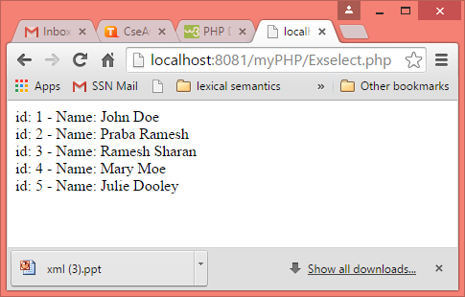
Output of selecting data

Slide 9
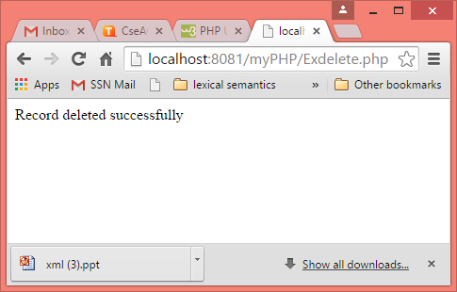
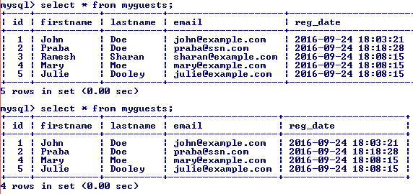
Deletion of Records
<?php
$servername = "localhost";
$username = "root";
$password = "saritha";
$dbname = "myDB";
// Create connection
$conn = new mysqli($servername, $username, $password, $dbname);
// Check connection
if ($conn->connect_error) {
die("Connection failed: " . $conn->connect_error);
}
// sql to delete a record
$sql = "DELETE FROM MyGuests WHERE id=3“;
if ($conn->query($sql) === TRUE) {
echo "Record deleted successfully";
} else {
echo "Error deleting record: " . $conn->error;
}
$conn->close();
?>

Slide 10
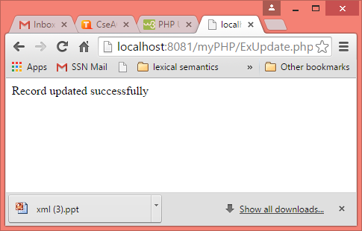
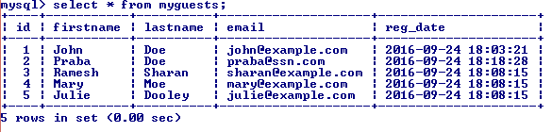
Updation of records
<?php
$servername = "localhost";
$username = "root";
$password = "saritha";
$dbname = "myDB";
// Create connection
$conn = new mysqli($servername, $username, $password, $dbname);
// Check connection
if ($conn->connect_error) {
die("Connection failed: " . $conn->connect_error);
}
$sql = "UPDATE MyGuests SET lastname='Doe' WHERE id=2“;
if ($conn->query($sql) === TRUE) {
echo "Record updated successfully";
} else {
echo "Error updating record: " . $conn->error;
}
$conn->close();
?>

